Slide 1

Project Fipple
Team members:
Aman Shukla(Champ)
Abhishek Jaiswal(Champ)
Dev Narayan(Champ)
Subodh Yadav(Champ)
Shashi Kumar Singh(Hustler)

Slide 2
Introduction
Fipple is an android app based automated solution to fill daily timesheet.
It smartly gathers user’s daily tasks based on his/her assigned JIRA tickets and outlook events.
Needs one time registration process and eliminates any further manual interaction.

Slide 3
Current Scenario and Issues
Users have to manually enter his/her daily tasks.
Most of the users forgot or choose not to fill the status on daily basis.
Time consuming (takes about 10-15 mins each time and even more if performed on weekly basis)
Weekly fill-ups results into inaccurate status entries.

Slide 4
Homepage

Slide 5
Basic workflow
Registers users based on JIRA, outlook and dashboard credentials.
Smartly gathers daily tasks data based on assigned JIRA ticket status and outlook events.
Provides collected data to backend status automation system.
Triggers timesheet fill-up as per current date.
Generates notification for daily status entries.

Slide 6
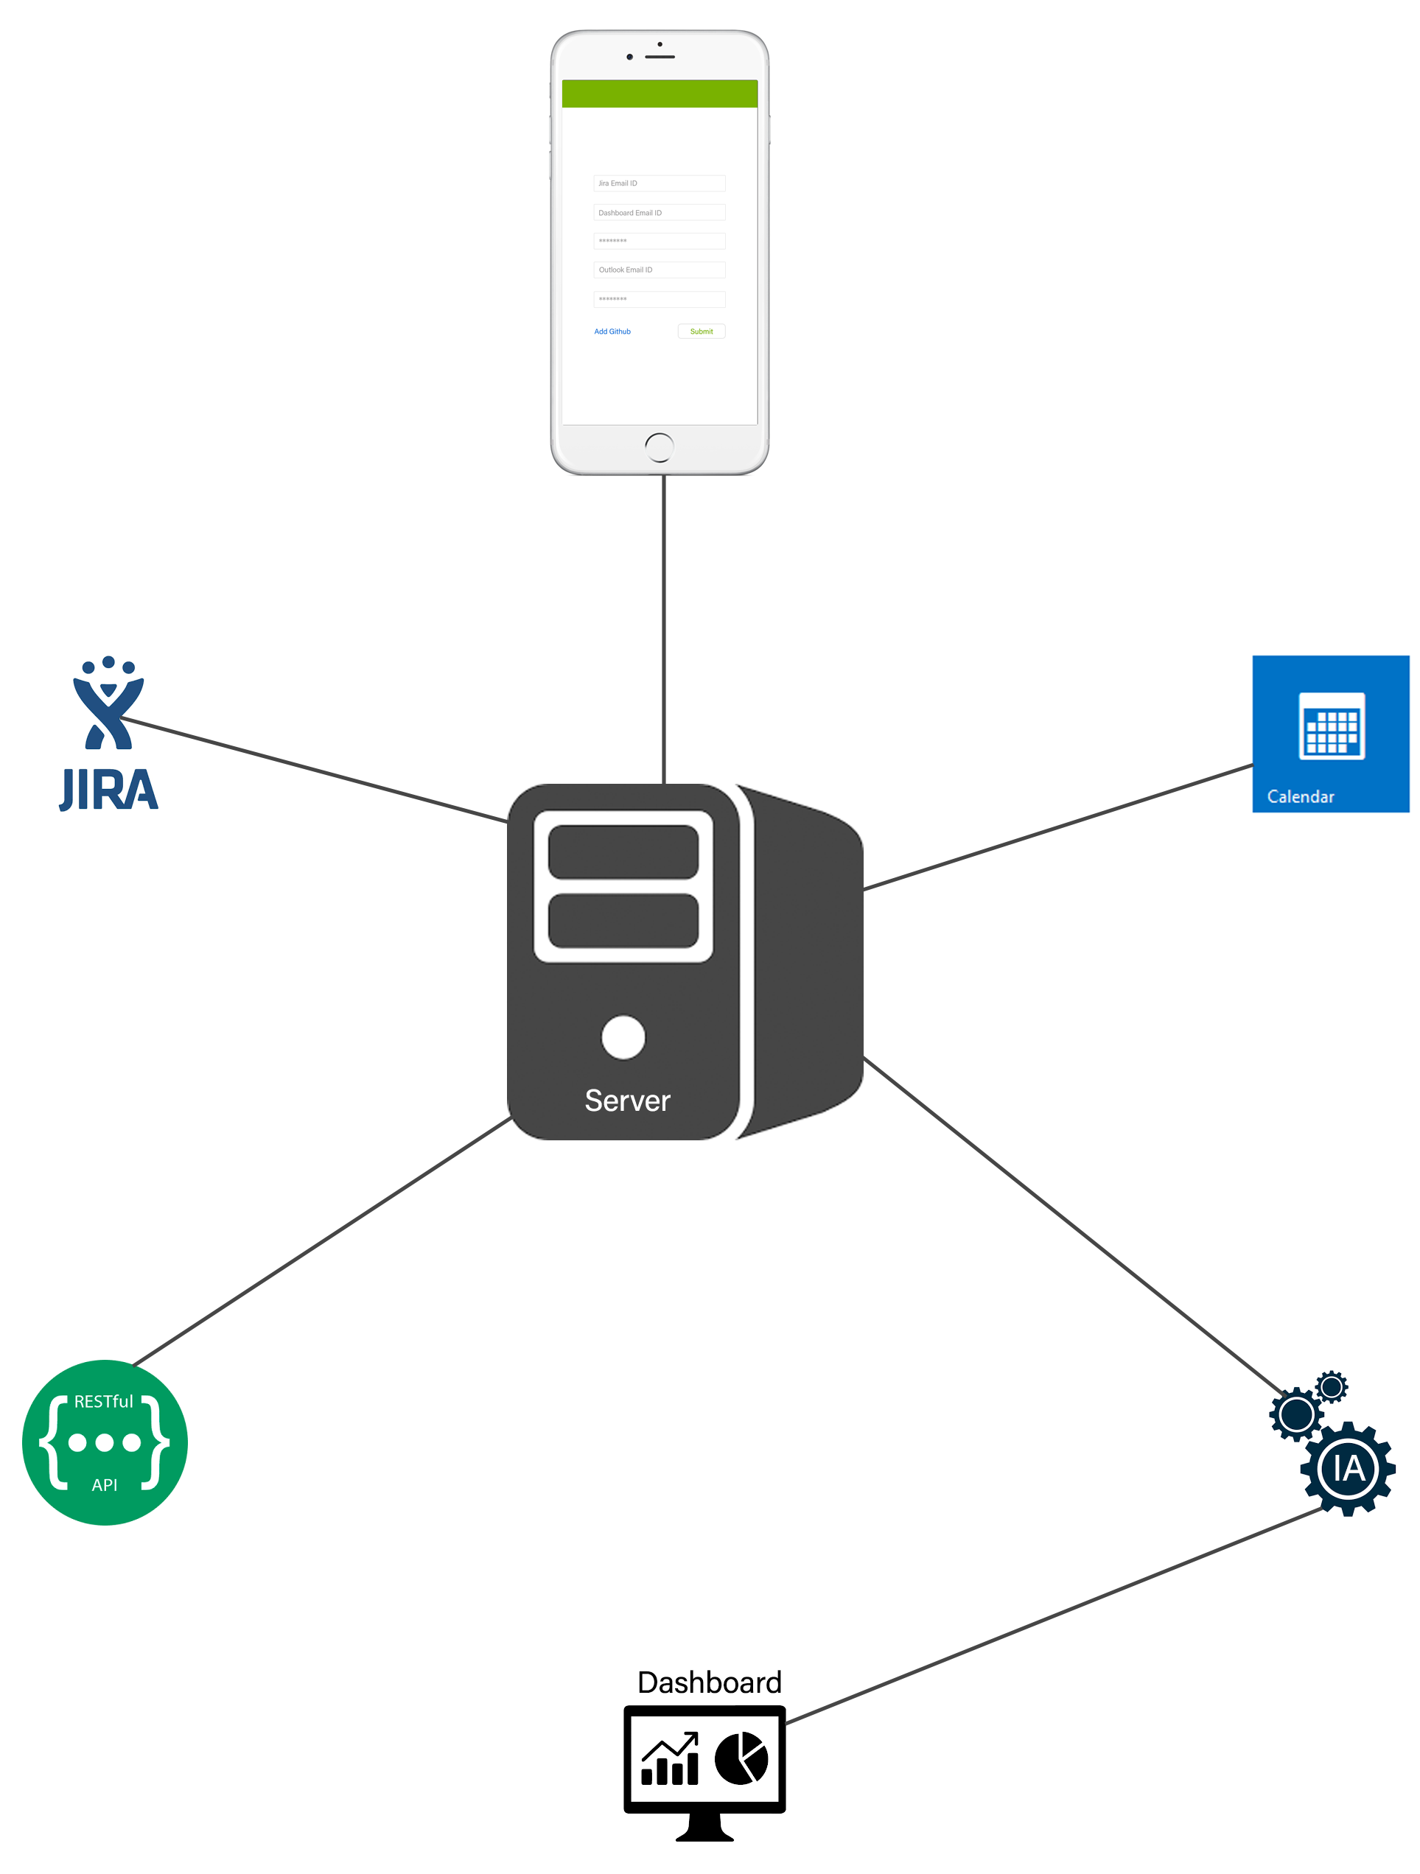

Slide 7
Future prospects
Integration with git-hub and bit-bucket accounts.
Scheduler based timesheet fill-ups.
Accept or reject auto-fill timesheet.

